Slide 1


Slide 2

Social Enterprise
Train the Trainer

Slide 3
Workshop Outline
Day One
Part 1: Getting to Know Social Enterprise
Part 2: Design Thinking
Day Two
Part 3: The Spirit of Social Enterprise
Part 4: Designing a Social Enterprise
Part 5: Application and Evaluation

Slide 4
Two Truths and a Lie
Write down three quite interesting things about you, two of which are true and one a lie. Make the lie believable.
The rest of the group have to spot the lie.
Notes:
Trainer to choose suitable icebreaker for their groups.
Recommended options are Bingo and Two truths and a lie
Bingo icebreaker directions
Make some space in the training room. Ask the participants to gather in the space – they each need a pen and the task sheet. Then, depending on the number of people taking part, they have to find one person for each picture, including you, – writing the participants’ names next to relevant picture as they go. The number of pictures can be adjusted if are their more or less participants. First to get names for all pictures calls bingo and stops the game. They can then stand in a ring and quickly introduce one person on their sheet.
Two truths and a lie directions
Each participant writes down three notable things about themselves- two are true and one is a lie. In turns, each participant tells the others their three things and the others have to guess which is the lie.

Slide 5
Bingo
Notes:
Trainer to choose suitable icebreaker for their groups.
Recommended options are Bingo and Two truths and a lie
Bingo icebreaker directions
Make some space in the training room. Ask the participants to gather in the space – they each need a pen and the task sheet. Then, depending on the number of people taking part, they have to find one person for each picture, including you, – writing the participants’ names next to relevant picture as they go. The number of pictures can be adjusted if are their more or less participants. First to get names for all pictures calls bingo and stops the game. They can then stand in a ring and quickly introduce one person on their sheet.
Two truths and a lie directions
Each participant writes down three notable things about themselves- two are true and one is a lie. In turns, each participant tells the others their three things and the others have to guess which is the lie.

Slide 6
Part One
Getting to Know Social Enterprise

Slide 7

TASK
1. Create a flipchart listing your experience of Social Enterprise (SE).
2. What is SE? Write your definition.
Notes:
NB: Here, there is a deliberate attempt to work out what the group knows, has experienced and think about SE - prior to any formal definition. It can help the trainer respond to the needs of the group and engage them actively early on. The trainer is trying to stimulate the energy and ideas of the group. The trainer is trying to avoid a passive learning experience, but does give a formal or best possible definition after the trainees have formulated their initial ideas.
Additional questions for discussion include: What are the values underpinning SE? What motivates people to become social entrepreneurs?

Slide 8
Defining Social Enterprise
Social Enterprises are businesses that trade to tackle social problems, improving communities, people’s life chances or the environment. They make their money from selling goods and services in the open market, but they reinvest their profits back into the business or the local community.
Social Enterprise UK 2015
Notes:
This slide can be replaced with a local definition
In the UK, Social Enterprises are businesses trading for social and environmental purposes. There are a several definitions in operation, but they are all broadly similar.
Social enterprises are businesses: they compete to deliver goods and services. The difference is that social purpose is at the very heart of what they do, and the profits they make are reinvested towards achieving that purpose.
The UK government defines social enterprises as “businesses with primarily social objectives whose surpluses are principally reinvested for that purpose in the business or in the community, rather than being driven by the need to maximise profit for shareholders and owners.”

Slide 9
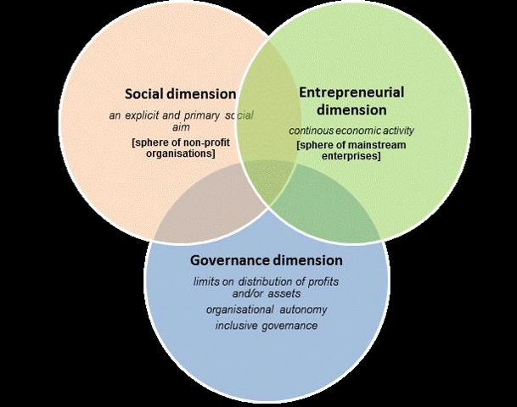
Defining Social Enterprise
Source: European Commission
Notes:
The following core criteria for SEs were established by the EU (2014):
The organisation must engage in economic activity: this means that it must engage in a continuous activity of production and/or exchange of goods and/or services;
It must pursue an explicit and primary social aim: a social aim is one that benefits society;
It must have limits on distribution of profits and/or assets: the purpose of such limits is to prioritise the social aim over profit making;
It must be independent i.e. organisational autonomy from the State and other traditional for profit organisations;
It must have inclusive governance i.e. characterised by participatory and/ or democratic decision-making processes.

Slide 10

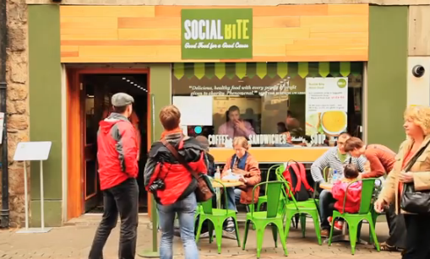
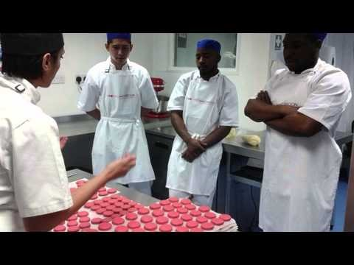
Social Enterprise Examples
Notes:
Suggested short films showing an example of a social enterprise. These can be replaced with local examples.
Follow the film with a group discussion: key notes and ideas added to a flip chart or online document.
NB: this page changes to suit local contexts- the current one reflects a UK context, but this should be changes for Italian, Swedish, Dutch, German etc.. contexts.
Here are a selction of videos- use those you think fit with your context.

Slide 11
Social Enterprise: The Money
There are two important elements to this:
The money you need to get started or grow your social enterprise, often called investment.
The money that needs to come in each month so you can pay running costs and keep going. (We will call this your business model- no SE can do without this)
Notes:
There are various SE business models. In the UK at least 50% of income must be commercially-sourced. Some SEs use a mix of funding and commercial income; some depend entirely of income. Clearly, models for smal SEs are very different from large SEs like Plymouth University.

Slide 12
Social Enterprise Business Models
There are almost as many ways of making money whilst doing socially useful work as there are social enterprises. Some examples are:
Miss Macaroon
  Trains and employs care leavers and other disadvantaged young people
  Sells a luxury product
  Re-invests profits in training and support for young people
  Elvis and Kresse
    Use discarded fire hoses that would otherwise go to waste
    Sell expensive handbags
    Donate 50% of profits to firefighters charities
    Streetleague
      Training and supporting young people into work through football
      Deals with football clubs and big sponsors to bring in money
      Grants and government contracts are 50% of income
Notes:
Often, the best social enterprise ideas combine being social and being enterprising in a new and interesting way!
NB: These UK examples can be replaced with more regional or national ones.
The Trainer should develop the examples by researching the SEs used and provide some human context (people relate to human, personal stories- so names, some background, some updated info perhaps).

Slide 13
TASK
Choose one of the SEs on the ESSE Best Practice page http://esseeurope.eu
What is their social purpose?
How do they generate income?
Social Enterprises are businesses with a social purpose. This means their activities must generate income.
Notes:
Use European examples on Esse website best practices
Use i-pads for accessing website
There are almost as many ways of making money whilst doing socially useful work as there are social enterprises. Some examples are:
Miss Macaroon
Trains and employs care leavers and other disadvantaged young people
Sells a luxury product
Re-invests profits in training and support for young people
Elvis and Kresse
Use discarded fire hoses that would otherwise go to waste
Sell expensive handbags
Donate 50% of profits to firefighters charities
Streetleague
Training and supporting young people into work through football
Deals with football clubs and big sponsors to bring in money (corporate philanthropy)
Grants and government contracts (50%)

Slide 14
Investment: Getting Started
Most entrepreneurs, social or otherwise, start with very little money. They use the resources they have available to try things out and build their business idea gradually
Some ways to access funding...
Small grants
Social Enterprise start up support
Crowdfunding
Notes:
Small grants
Grants such as Awards for All are easy to apply for and can be used to get a socially useful project off the ground while you develop the longer term business model
Social Enterprise start up support
This is usually consists of a small grant, often with the option of more money as your idea develops, plus advice and mentoring to help you on your way. UnLtd are one of the best known providers
Crowdfunding
Online platforms which encourage lots of individuals to each contribute a small amount work well when backed up by a strong social media and marketing campaign. Crowdfunder is one example.

Slide 15
Investment: Growing Your Social Enterprise
Like all businesses, social enterprises can seek investment to develop new products or services, expand or improve what they do
Mainstream funds
Social investment
Small grants, social enterprise start up support, crowdfunding
Notes:
Mainstream funds
Social enterprises can access bank loans in the same way as any other business.
Social investment
Social investment funds lend money to social enterprises. They want to see that the money will do good. Once it has been repaid with interest, they will often lend it again to other social entrepreneurs.
Social investment can also take the form of equity. An investor buys a share of the business and in return takes a share of the profits. There is a legal cap on how much equity can be sold and how much of the profit can be paid out.
Grants, social enterprise support schemes and crowdfunding
All of these can help with growing a social enterprise as well as with starting one.

Slide 16
Funding and Finance: More Information
http://www.socialenterprise.org.uk/advice-services/topic/finance
http://www.theguardian.com/social-enterprise-network/2014/feb/10/how-to-guide-funding-your-social-enterprise
http://www.businesszone.co.uk/do/people/the-ultimate-guide-to-raising-finance-for-a-social-enterprise
Notes:
Adapt to local context.

Slide 17
Social Enterprise Quiz
...put your notes away

Slide 18
Part Two
Design Thinking

Slide 19
Creative Thinking
Design a test for the idea
Select the best idea
Brainstorm ideas
Form insights about the users
Describe the potential users
Initial SE ideas or scenarios
Notes:
The afternoon session is about exploring some potential SE scenarios using design thinking methods.
Here is a shrt video about deisgn thinking: https://www.youtube.com/watch?v=a7sEoEvT8l8

Slide 20


Step 1: identify potential SE business ideas
Suggested scenarios
Example 2:
A new kind of holiday for people on low incomes.
Example 1:
Personal transport solutions for adults with very limited budgets.
Example 3:
An online store and app to buy eco-friendly products.
Example 5:
Opportunities for young people who say they can’t afford to leave their family home.
Example 4:
A new kind of affordable hairdressing salon and/or barbers.
Notes:
Change to suit your group and their context.
To create scenarios, think about problems or needs in your group’s area which need addressing.
The tutor can allocate scenarios or let groups decide.
NB: smaller workshop groups can use less scenarios. Ideal group size for each scenario is 3-5.
The idea here is that the trainees link the issues on the previous slide to these SE business ideas.

Slide 21
Step 2: describe the customers or clients
Describe the customers or clients for this business – what they do, what they need, how they live etc. Do not interpret this – merely describe or make observations.
Focus on extreme users
NB: the reason why we focus on extreme users is that they tell us more about the service or product and how it/they are used - it brings out more than would be seen observing standard customers or users.
Notes:
Groups may need extra guidance to help them avoid interpreting users- the task here is to describe.

Slide 22
Step 3: form insights
Consider the motivations, thoughts and values of the users, customers or clients. Select insights based on their ability to reveal how people think or feel.
Rate the insights: (number one is highest or best).
Notes:
Timing: about 10-15 minutes

Slide 23

Step 4: brainstorm and visualise ideas
Select your top insights from the previous task (no more than three).
Using these insights, brainstorm products or services to meet the customers’ needs and serve a social or environmental purpose.
Note: When you brainstorm the ideas, defer judgement, encourage wild ideas and lots of ideas; visualise (sketch) and build on others’ ideas.
Notes:
NB: this process needs a leader for each brainstorming group, who directs and control the group’s focus and to ensure the group all think about one idea at a time.
Visual representation of ideas should be encouraged: cartoons, stick people- anything to generate more visual depictions of the ideas.

Slide 24

Step 5: each group selects the best idea...
...the one that is the most inspirational, meets a real need or solves a real problem and is relevant to the original idea of a SE business.

Slide 25
Step 6: devise a simple storyboard to explain the SE idea and see if it is both workable and beneficial.
Storyboard
The current situation or the problem | Our idea | How it can make money | Benefits for the people affected | How this SE will improve the world
Notes:
The point is that the groups envisage their ideas. This will help the group or nascent SE business test the water or check the idea is workable.

Slide 26

Sharing ideas
Each group briefly presents:
How they arrived at their chosen idea
Overview of the idea
The experiment to test if it works
Our idea!
Notes:
Groups can use their storyboards and/or flipcharts to augment their personal presentations.

Slide 27
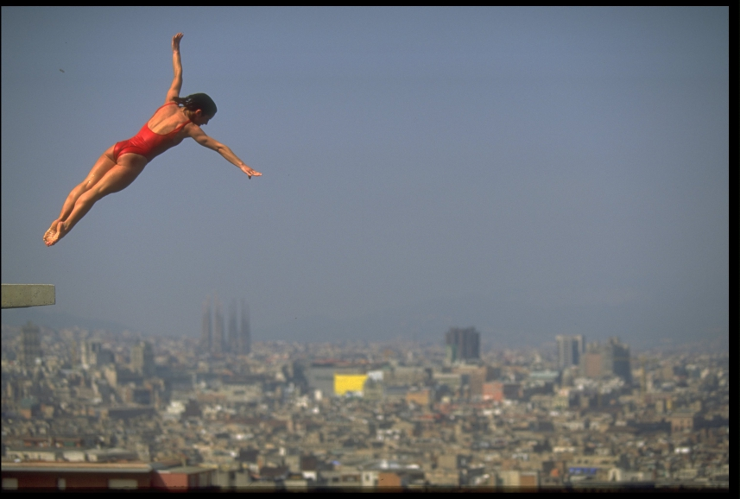
Springboard
Think about your own SE ideas for day two.
Remember to think about SE ideas in response to social or environmental issues, or good ideas which can be used to help tackle such issues.
Tomorrow, we will select some of your ideas to develop together.
Notes:
This slide is a fairly open summary of day one.
NB: in education, the first question is about creating tangible applications in the real world (forging new mental frameworks in the mind); the second is about the actions which could be taken to get the idea up and running.
The final part is a group reflection.
Possibly, the trainer can preview the next day- but the trainees will be tired, so maybe just the highlights.

Slide 28
Reflection
How will you use what you have learned today?
Notes:
This is an opportunity, at the end of day one, for participants to think about why they are on the course and how will they use what they have learned (changing hats from trainee to future trainer). Energy is typically low at this stage of the course, and people want to get away, so the task should be active and pacy.
Suggestions include:
Flipchart carousel with “What did we do today” “How did it feel?” “What have I learned?” and “How will I use it?”
Paired conversations, with each person feeding back one point to the group

