Slide 2
Workshop Outline
Day One
Part 1: Getting to Know Social Enterprise
Part 2: Design Thinking
Day Two
Part 3: The Spirit of Social Enterprise
Part 4: Designing a Social Enterprise
Part 5: Application and Evaluation
Notes:
Ideas…
Start day two with two premises: 1) create an SE idea in response to an issue or problem to be solved; 2) develop the idea along realistic financial lines.
Groups work on particular projects as a means to explore how to create an idea for an SE and develop this into a draft business plan, using critical discussion and reflection to anticipate issues etc.
Create and experiment to see if the SE idea has real potential (building upon the storyboarding idea in day one).
Financing SE- a more developed section germane to the context.
Refine ideas, plans, contexts and prepare a revised business plan and action plan.
Final reflection and networking.

Slide 3
Part Three
The Spirit of Social Enterprise

Slide 4
Thinking about what SE can do for our world

Slide 5
TASK
How could SE change our world?
Notes:
This is all about the impact of SE on our world- our social, economic and natural world. It serves to foster and consolidate the ethical core of SE.
Show the video
Get people to work in small groups on the task
Whole group discussion on the topic, with the trainer summarising key themes or questions
Other resources (UK): Social Enterprise Report 2015
Whole group summary: put main ideas on flipchart or board. Maybe use ‘Padlet’. http://padlet.com/features

Slide 6
Theory of Change
How will my social enterprise idea achieve the change I want to see in the world?

Slide 7
Outcomes Approach
Inputs
Resources invested, activities carried out
Outputs
Direct results of activities. e.g. number of people helped
Outcomes
Changes as a result, e.g. more confidence, more employable

Slide 8
Theory of Change and Impact Measurement TASK
Thinking about the social enterprise idea you generated yesterday:
State the social purpose
Create a diagram showing how the activities will achieve the social purpose (You might need to make some assumption. What are they?)
What would you measure to find out whether your enterprise is achieving its social purpose?

Slide 9
Social Impact Measurement: More Information
http://www.iridescentideas.com/prove-it.html
Notes:
Social impact measurement is a huge field, so for this course we will just show a local social impact report e.g. Bike Space and signpost additional information

Slide 10
Part Four
Designing a Social Enterprise

Slide 11
TASK
Discuss issues which could be solved or improved by a social enterprise.
Notes:
The trainer will need some prepared social issues to useas a backup.
care for the elderly
lack of nhs dentists
jobs and business opportunities in the outlying estates

Slide 12
Choosing SE Ideas
Think of a business idea to address one or more of these issues.
Remember the different business models covered in part one.
Notes:
Preferably, the participants use their own SE ideas, but the trainer should have some back up ideas for groups to work on.
At this stage, the idea doesn’t need to be in any detail. That will all come later.

Slide 13
Creative Thinking
Design a test for the idea
Select the best idea
Brainstorm ideas
Form insights about the users
Describe the potential users
Initial SE ideas or scenarios
Notes:
The afternoon session is about exploring some potential SE scenarios using design thinking methods.
Here is a shrt video about deisgn thinking: https://www.youtube.com/watch?v=a7sEoEvT8l8

Slide 14
Step 2: describe the customers or clients
Describe the customers or clients for this business – what they do, what they need, how they live etc. Do not interpret this – merely describe or make observations.
Focus on extreme users
NB: the reason why we focus on extreme users is that they tell us more about the service or product and how it/they are used - it brings out more than would be seen observing standard customers or users.
Notes:
Groups may need extra guidance to help them avoid interpreting users- the task here is to describe.

Slide 15
Step 3: form insights
Consider the motivations, thoughts and values of the users, customers or clients. Select insights based on their ability to reveal how people think or feel.
Rate the insights: (number one is highest or best).
Notes:
Timing: about 10-15 minutes

Slide 16
Step 4: brainstorm and visualise ideas
Select your top insights from the previous task (no more than three).
Using these insights, brainstorm products or services to meet the customers’ needs and serve a social or environmental purpose.
Note: When you brainstorm the ideas, defer judgement, encourage wild ideas and lots of ideas; visualise (sketch) and build on others’ ideas.
Notes:
NB: this process needs a leader for each brainstorming group, who directs and control the group’s focus and to ensure the group all think about one idea at a time.
Visual representation of ideas should be encouraged: cartoons, stick people- anything to generate more visual depictions of the ideas.

Slide 17
Step 5: each group selects the best idea...
...the one that is the most inspirational, meets a real need or solves a real problem and is relevant to the original idea of a SE business.

Slide 18
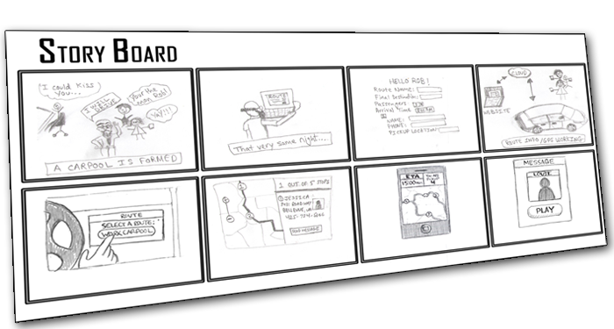
Step 6: devise a simple experiment to test the idea and see if it is workable
Use a storyboard to explain the experiment
Notes:
The point is that the groups envisage ways of testing their ideas out- testing them as prototypes. This will help the group or nascent SE business test the water or check the idea is workable.

Slide 19
Sharing ideas
Each group briefly presents:
Our idea!
Notes:
Groups can use their storyboards and/or flipcharts to augment their personal presentations.

Slide 20
Theory of Change
How will my social enterprise idea achieve the change I want to see in the world?

Slide 21
Investment: Getting Started
Where will I find the resources to start my social enterprise?
Notes:
Small grants
Grants such as Awards for All are easy to apply for and can be used to get a socially useful project off the ground while you develop the longer term business model
Social Enterprise start up support
This is usually consists of a small grant, often with the option of more money as your idea develops, plus advice and mentoring to help you on your way. UnLtd are one of the best known providers
Crowdfunding
Online platforms which encourage lots of individuals to each contribute a small amount work well when backed up by a strong social media and marketing campaign. Crowdfunder is one example.

Slide 22
TASK
Prepare a pitch for your social enterprise idea, including either
How you will finance the start up
OR
Your theory of change and how you will measure your social impact
Notes:
Trainer facilitates presentations- no more than 10-15 each, including Q&A.
Time for preparation of presentations: approx 20-30 mins.

Slide 23
TASK
Peer insights from critical friends
Consider the other groups’ presentations and develop some critical, insightful feedback about the SE ideas, the business models and the finance options or theory of change.
Notes:
Trainer supports group-work and facilitates feedback.
This could be a well-developed series of interconnected discussions.
Trainer to use informed interventions where necessary to keep things constructive and supportive.

Slide 24
Part Five
Application and Evaluation

Slide 25
Reflection and Application
Work in pairs. Write the answers on post-its
What have you learned?
Any questions remaining?
Where will you use what you have learned?
What is my first step? (keep this one)
Notes:
Pairs work on these questions
Use post its
Trainer situates flip chart paper or boards around the room to collect post-its on each question.
Read out some of the post-its.
Ensure remaining questions are answered or signposted.
Get people to read out their first step.

Slide 26
Resources and Support
Starting a social enterprise in Plymouth:
http://plymsocent.org.uk/start-a-social-enterprise-in-plymouth/
The ESSE community: http://esseeurope.eu/
Notes:
Recommended that each local partner creates signposting information for local social entrepreneurs.

Slide 27
Evaluation

